Slide 1
Analysis of the program for works for social benefit (WSB)
Research undertaken for the:
Observatory of Social Policy in Podlaskie
Co-financed by the European Social Fund (European Union), Human Capital Operational Program 2007-2013, Sub-measure 7.2 Promotion of social integration and social economy sector; Sub-measure 7.2.1 Rising the level of occupational activity and social integration of people in danger of exclusion
by Coffey International Development

Slide 2
Research methods
Desk research
analysis of documents regulating institutions’ legal framework and implementation of programs for the social profit
In depth interviews with key representatives of:
Questionnaire to Local Labour Office (LLO) and Centre for Social Assistance
Part I: data for projects related to projects for social profit
Analyzing data from Information System Syriusz
characteristics of PSP participants
Regional Centre of Social Policy (RCSP)
In depth interviews with the representatives of LLO and CSA
representatives of 4 CSA: management team and social workers
Case studies with participants of projects for social benefit
Presentation of individual cases participating in projects for social profit
In depth interviews with WSB organizers
With the representatives of the institutions for which projects for social profit were run
reports and other papers related to works for social profit (country level and regional level)
reports from various research and publications related to institutions of the Polish labour market and social support system
Voivodeship Labour Office (VLO)
Ministry of Labour and Social Policy
situation of the employed and unemployed
Part II: cooperation VLO with CSA
Part III: analyzing opinion on the projects for social profit
representatives of 4 LLO: management team and employment counselor
Analyzing their motivations and opinions on the project

Slide 3
On Program for Social Benefit (WSB)
Introduced on November 1st, 2005 on the basis of Act from July 28^{th,} 2005 r. on changes in promoting employment and labour market institutions and other related, legal changes.
They are works deputed by the county office (LLO), run by CSA, other organizations and institutions involved in charity works and in the projects for social profits.
People who can participate in the program are those without the right to unemployment benefits but having social assistance, participating in social contracts, schemes for self reliance, local programs for social security or schemes for social support, if they are directed by the LLO.
Programs’ organizator is commune (local authority) which organizes works for the local community after the agreement with the recipients of the projects and LLO.
Person who is unemployed and directed to participate in WSB, can do 10 hours a week upon agreement on the reward per hour. Works for the social profit are funded from the commune’s budget and Labour Fund (starost refunds commune from the Labour Fund budget up to 60% of the minimum service cost).

Slide 4
Goals of the program
Main aims of the program for the social benefit:
Enhancing the adaptability of the employees
WSB should aim to find employment for people
LLO’s perspective
Social integration
WSB should encourage people to seek activities outside the house and increase their self-esteem
CSA’s perspective
Support from the organizers
WSB should coordinate simple works of the involved institutions
Organizers’ perspective
Financial support
WSB should support people in the difficult financial situations
Participants’ perspective

Slide 5
Characteristics of the participants of the projects for social profit in voivodeship of Podlaskie
age
People 40-60 year-old
gender
Mostly women (55%)
education
Most people without A-Level (matura) (79%)
Average age: 45 year-old
Young people rarely participate due to lack of interest
Most women are from province of suwalskie (67%)
Most men are from the county of bielsko (58%)
Most people with vocational education
Most people without any professional qualifications are from the city of Lomza and in the province of lomzynskie
job situation
professional experience
situation on the labour market
People who have been unemployed for a long time
Some people with disabilities; most of them are in the province of bielsko (17%), least in the province of wysokomazowieckie (0%)
People who did low-skill jobs but currently unemployed
Before many alcoholics but currently after people after the treatment
People without any professional experience
People seeking any employment (mostly women)

Slide 6
Requirements for the people directed to get involved in program for the social profit
While distributing works for social profits the following are taken into consideration: age, person's ability to do the work and his/her qualifications.
§ 4. 2. act on organizing the program for social profit (Dz.U. Nr 155, poz. 921).
Final decision who is entitled to participate in projects for social profit depends on:
Institutions’ demand to carry works for social profit
Preferences of the social workers who select candidates among its clients

Slide 7
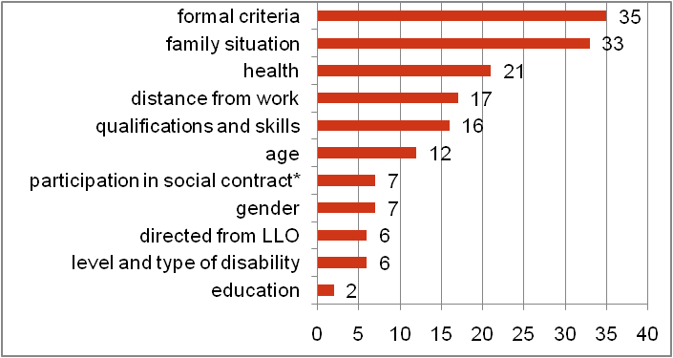
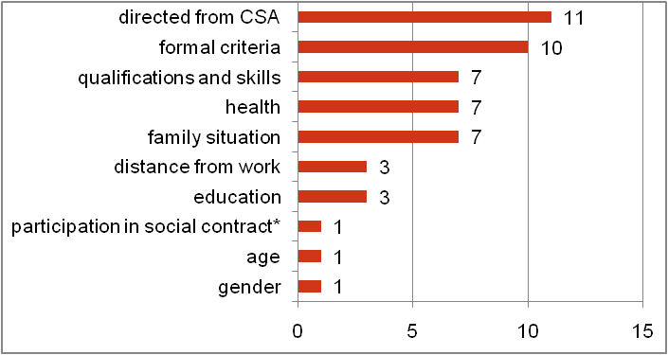
Selection criteria for the projects for social profit
CSA’s criteria for selecting people for the WSB (N = 49)
„It is some type of reward and promotions as you know how difficult it is to find a job nowadays.”
„(…) for the person to be fairly responsible”
„When I applied to CSA, I included in my application all the skills a person should have”
LLO’s criteria when selecting people for the WSB (N = 14)
„Nowadays, CSAs take more care when selecting people for the works for social profit”
*I participated in the social contract , in the scheme for self reliance, local program for social security, or scheme for social self employment.

Slide 8
Involvement of LLO, CSA and local authorities in supporting people in danger of social exclusion
Average level of LLO’s engagement and local authorities in supporting people in danger of social exclusion in the opinion of CSA in the county of podlaskie (N = 49)
LLO
commune
In all CSAs
In all CSAs organizing WSB in 2012
In CSAs not organizing WSB in 2012
Average level of engagement of CSAs in promoting adaptability of people in danger of social exclusion in the opinion of LLO in the voivodeship of podlaskie (N = 14)
CSA
Among all LLOs
Among all LLOs organizing WSB in 2012
Among all LLOs not organizing WSB in 2012

Slide 9
Barriers in implementing projects for social benefit
Barriers in implementing WSB in the opinion of CSA members (N = 49)
Lack of interest among unemployed
The interest in projects for social profit vary from very low to very high
Local authorities prefer to spend their budget on other forms of social security
Lack of financial support from commune
Lack of funds from Labour Fund
Poor level of CSA services
Lack od demand for WSB from communes
Too complicated procedures for running WSB
High competition for providing services to commune
County Public Employment Services do not notice high level of interests for WSB:
Amongst their clients
Amongst local authorities
Barriers in implementing WSB in the opinion of LLO members (N = 14)
Lack of interest from the unemployed
Lack of demand for WSB from communes
Poor level of CSA beneficiaries’ services
Lack of funds from Labour Fund
Too complicated procedures for running WSB
High competition for providing services to commune

Slide 10
Effectiveness of works for social profit
Employment effectiveness among certain areas of the labour market in the voivodeship of podlaskie (%)
Category of the unemployed | Subsidized employment | Public works | Trainings | Internships | Employment competence | Works for the social benefit | Career counseling | Activities for job adaptability
Women | 76,6 | 50,6 | 36,7 | 49,7 | 42,9 | 31,1 | 23,9 | 13,5
People unemployed for a long time | 63,3 | 36,5 | 34,7 | 50,0 | 50,0 | 24,1 | 16,9 | 11,7
People up to 25 year-old | 85,5 | 55,6 | 51,9 | 50,5 | 33,3 | 37,5 | 30,5 | 18,6
People 50+ | 63,1 | 37,2 | 29,6 | 49,7 | – | 23,7 | 15,4 | 18,0
People without professional qualifications | 70,2 | 37,6 | 25,8 | 43,8 | 46,2 | 27,9 | 16,2 | 12,4
People without professional experience | 83,8 | 52,8 | 37,2 | 47,4 | 28,6 | 26,6 | 25,2 | 14,6
People having criminal records | 57,1 | 100,0 | 35,7 | 37,5 | – | 12,5 | 8,5 | 3,2
Disabled | 65,0 | 38,9 | 26,1 | 53,8 | – | 34,8 | 26,9 | 21,1
People living in rural areas | 72,3 | 44,0 | 52,5 | 50,4 | 50,0 | 29,9 | 21,1 | 13,5
Migrants | 75,0 | – | – | 40,0 | – | 36,4 | 19,6 | 20,0
Unemployed altogether | 73,7 | 45,1 | 47,4 | 50,9 | 37,0 | 26,3 | 22,8 | 14,0
Source: data from the Public Employment Services in Białymstoku on the basis of Annex 6.

Slide 11
Effectiveness of projects for social profit
Employment effectives amongst WSB participants in the podlaskie region in 2011
Number of people participating in the program
People who found employment*
Effectiveness
* Participating in the program or those who completed the program 3 moths previously.
** Participation of those who are competing the program.
Source: VLO in Białystok, Annex 6

Slide 12
Role of the WSB in supporting people in danger of social exclusions
Most common profits from WSB in the eye of CSA and LLO representatives
1. Improving family material conditions of the person participating in WSB
2. Social integration, including:
Making new social contacts
Increased level of responsibility and self discipline
Activities outside the house
3. Increased self-esteem
4. Increased motivation to act and seek a job
Main profits of WSB according to the participants are number 1,2 and 3.
Main profits according to the organizers
Other profits of WSB according to the representatives of CSA and LLO:
Acts against social exclusion
Limits level of social benefits
Develops awareness of the environmental issues
Moderates the side effects of local unemployment
Temporary active on the labour market
Verification of social and professional skills
Enabling the organizers to undertake simple and urgent tasks without employing new people
Closer cooperation between CSA’s workers and project participants in planning, organizing and realizing the projects

Slide 13
Conclusions and recommendations part 1
1. Lack of clear definition of the goals of WSB
2. Low level of utilization
It is necessary to carefully plan WSB on the country and regional level. It seems to be necessary to create a body of representatives of institutions engaged in coordinating WSB, issues related to labour market and social security on the voivodeship level. Member of that body should be: regional representatives of VLO, Regional Centre for Social Policy, LLO and CSA as well as other institutions engaged in social programs, NGOs and local authorities.
Level of WSB utilization should be the focus of discussion to establish WSB aims, local authorities budget for the projects and funds from the Labour Fund.
This body should focus their work with the representatives of local authorities which do not run WSB.
WSB can become an important tool, next to institutions for addressing social security and labour market issues. It is crucial to customize the program to the needs of people and local environment. Smartly combined with other social and labour market institutions WSB can significantly improve the situation of those struggling to improve their position on the labour market.

Slide 14
Conclusions and recommendations part 2
3. Miscellaneous level of utilization
4. Program directed towards two groups of clients.
It is important to change the attitudes towards WSB among representatives of commune (local authorities), LLO and CSA by promoting good practice in order to implement WSB on a voivodeship level. Available data should be based on good practices in order to promote benefits from WSB to all stakeholders. Good practices should be described in research projects and calls for proposals. It is advised to implement suitable research for each region.
The support should be aimed at people who are most likely to use it best (having highest level of effectiveness) or people in most need to improve their material conditions. Precisely established aims enable to identify people who should use WSB in the first place. Alcoholics undertaking treatment should be given different type of support and should be directed to WSB after the treatment.

Slide 15
Conclusions and recommendations part 3
6. WSB routinely organized
5. Changes in the recruitment system to the WSB
Selecting people entitled to WSB, CSA be guided by their experience which vary form region to region depending on: the local conditions, local problems, interest from the local authorities and people’s needs.
WSB need promotion on among local authorities which has not participated in them so far. Information abut them should be directed towards mayors who have the capacity to introduce them in their communities ( it is advised that the information campaign should be initiated by the Ministry of Labour and Social Policy).
It is necessary to carry a discussion on the results of WSB, its effectiveness and future improvements. To achieve this, it is necessary to organize a public debate with all interested actors and participants.

Slide 16
Conclusions and recommendations part 4
8. WSB supports actions against inefficacy
7. WSB is outside Active Labour Market Policy and other forms of social security.
WSB are planned on an annual basis and directed towards people unemployed for a long time. Thus, when preparing a social contract, a client can be pointed to WSB. In the case of Individual Action Plan it is necessary to ensure that LLO fulfill their legal duties to prepare Action Plan no longer than 90 days after the completion of the program.
To maintain participants activity in the WSB and their positive image among family members, it is necessary to support their adaptability. At the end of the participation in the program it is advised for the clients to move to other social support schemes. This could be discussed with career counselors in advance, before the program ends.

Slide 17
Conclusions and recommendations part 5
10. WSB maintains the segregation of female and male jobs.
9. WSB are not related to the development of social economy.
It is advised to combine WSB with directing clients to the centers of social integration, clubs for social integration and programs supporting unemployed to open social cooperatives (or other forms of social enterprises). Career counselors and social workers should inform WSB participants about available workshops and trainings related to social economy. Those actions are taking place in the Regional Centre for Social Policy in the voivodeship of podlaskie.
In the application forms to the organizers of WSB and CSA it is advised to remove information on gender in the jobs description and focus on the person specification and job requirements.

Slide 18
Conclusions and recommendations part 6
11. WSB does not enhance cooperation between LLO and CSA
12. Process of organizing WSB is overregulated
It is advised to promote partnership between CSA and LLO in the voivodeship of podlaskie. Actions such as under the project „Be Active, Be the Best – workshops and professional consultancy for the employees of the social support institutions” (project run by Regional Centre for Social Policy in Białystok should be undertaken more frequently – especially where the partnership is limited. Cooperation among institutions is necessary also upon the project completion – it is advised to undertake similar schemes after 2012. In the meetings between LLO and CSA should participate not only the management teams of those institutions but also employees of internal units who should work together in organizing support for the people in danger of social exclusion.
It is advised to introduce changes at the system level. Legislator requires from institutions involved in the organization of WSB, to run very detailed documentation in three bodies engaged in the organization of WSB (organizers, CSA and LLO) and require from them hour settlements on the weekly basis. Those rules should be soften by moving to reporting and doing hour settlements on the monthly basis. This would make the organization of WSB easier and lighten CSA and LLO workers load and help to plan participation of the WSB organizers according to the needs of the institution in the sector in which they provide their services.

Slide 19
Thank you for your attention. More information in: Analysis of the program for social profit in the voivodeship of podlaskie

